Slide 1
Tema 3. Locations
Autoacceso-USBI
Veracruz
Lengua I

Slide 2
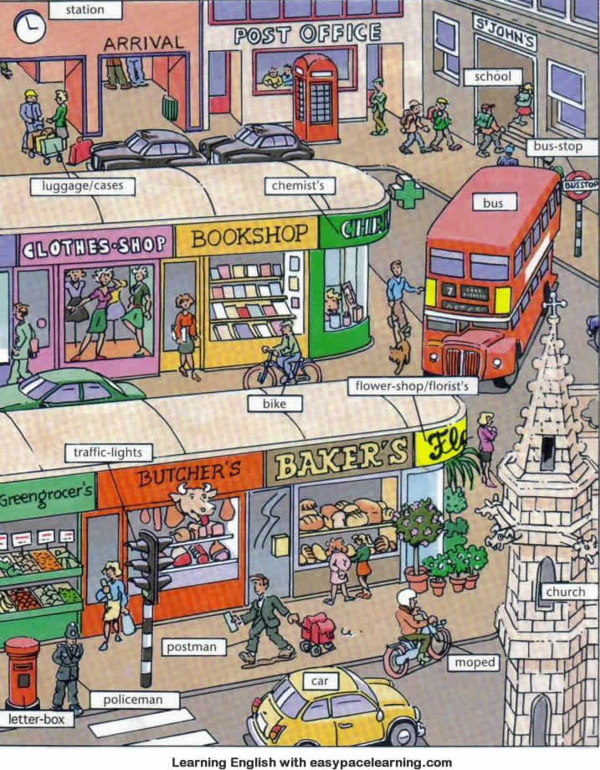
Tema 3
Lengua 1
Study the vocabulary

Slide 3
Tema 3
Lengua I
Excuse me…
Where’s the …?
Where are the …?
Is there a …?
Are there any …?
There is a … / There are…
Yes, there is one on …
It’s about … minutes from …
How do you go to school / work?
on foot
by car/ taxi/ bus I take a bus / a taxi.
I walk to school.
I ride my bike to school.
I drive to work.
Thanks a lot!
No problem!
That’s right.
Is it on …?
Yes, that’s right

Slide 4
Lengua I
Click to see the answers:
Place where I can buy medicine.
stadium
drugstore in Veracruz?
City Hall
The administration building of a city government
Opposite of:
It's on the right
A sports arena with tiered seats for spectators
e the How do I get to the Post office? post office?
Walk up
The main business section of a city
It’s on Juan Pablo II Ave.
It’s on the left
Complete:
How _____ I ______ to the post office?
Synonym of
Walk up
downtown of a city:
Where is the
Self-access USBI in Veracruz?
To miss catch
bridge
Is there a drugstore near here?
You can’t miss it
Word that means going out way. To leave
This verb means: to fail to meet or catch
A structure that reaches across a river, road, etc., and provides a way of crossing
Traffic lights
A parklike Area in which live animals are kept in cages or large areas so that the public can view them.
until
Yes, there is/
No, There isn’t
With this expression you mean that the place you are looking for is there.
Going EXIT way. To leave
A set of signal lights used to direct traffic at intersections
A ZOO
Complete:
Go straight ahead_____ you get to the bus stop.

Slide 5
Tema 3
Lengua I
Study the questionnaire
Place where I can buy medicine. Drugstore
A sports arena with tiered seats for spectators Stadium
Synonym of Walk up Go up
A set of signal lights used to direct traffic at intersections. traffic light
A parklike area in which live animals are kept in cages or large, closed-off areas so that the public can view them. Zoo
The administration building of a city government City Hall
Complete: Turn____________. Turn right/turn left
A structure that reaches across a river, road, etc., and provides a way of crossing. Bridge
The main business section of a city: Downtown
Going out way. To leave exit
This preposition means in the space separating. between
This preposition means close to or near to another next to
This preposition means: below the surface of under
This verb means: to fail to meet, catch To miss
Complete: Go straight ahead________ you get to the bus stop. until
Where is the Self-access USBI in Veracruz? It’s on Juan Pablo II Ave. / In front of Mac Donald’s/ On the cornero f Juan Pablo II Y Ruiz Cortínez Avenues.
With this expression you mean that the place you are looking for is there. You can find the place easily. You can’t miss it!
Is there a drugstore near here? Yes, There is/ No, there isn’t

Slide 6
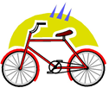
Tema 3
Lengua I
How do you go to school?
By bus | By bike | By car | On foot | I walk
I go to school by bus | I go to school by bike | I go to school by car. | I go to school on foot | I walk to school.
Adapted from Islcollective
Study your glosario

Slide 7
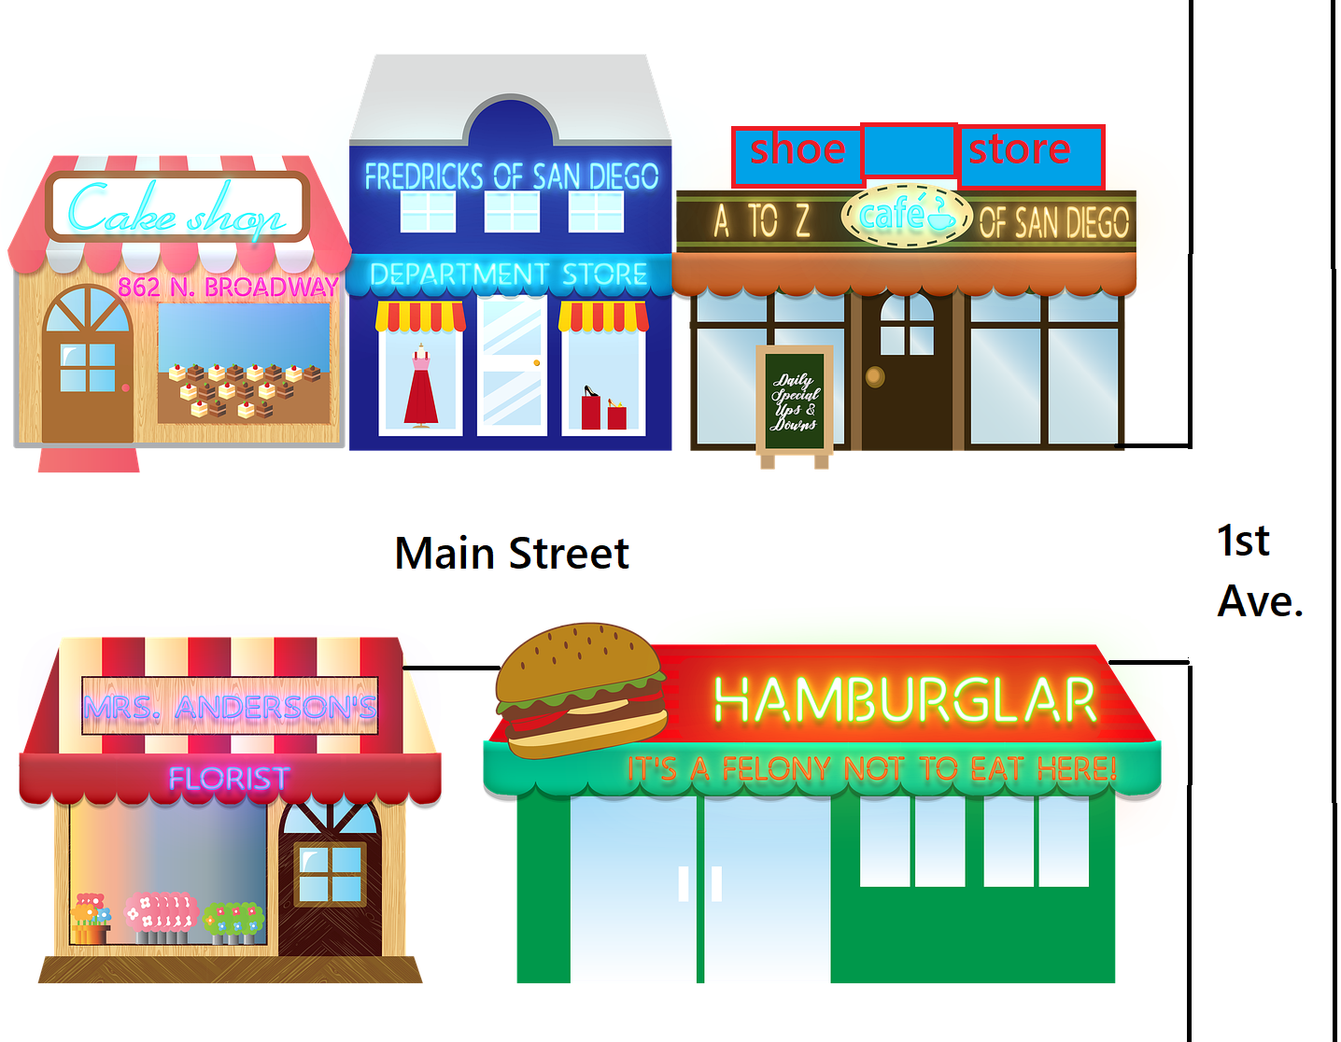
Tema 3
Fill in the blanks:
The Department store is _________ the bakery and the café.
The burger shop is __________the she store.
The Shoe store is ___________ the café.
The café is _______________Main Street and 1st Ave.
The bakery is __________ Main street.
between
next to
behind
on the corner of
on

Slide 8
Material elaborado por:
Dra. Asunción Coutiño Clemente
Asesora de Autoacceso-USBI
Veracruz.
acoutino@uv.mx

