Slide 1
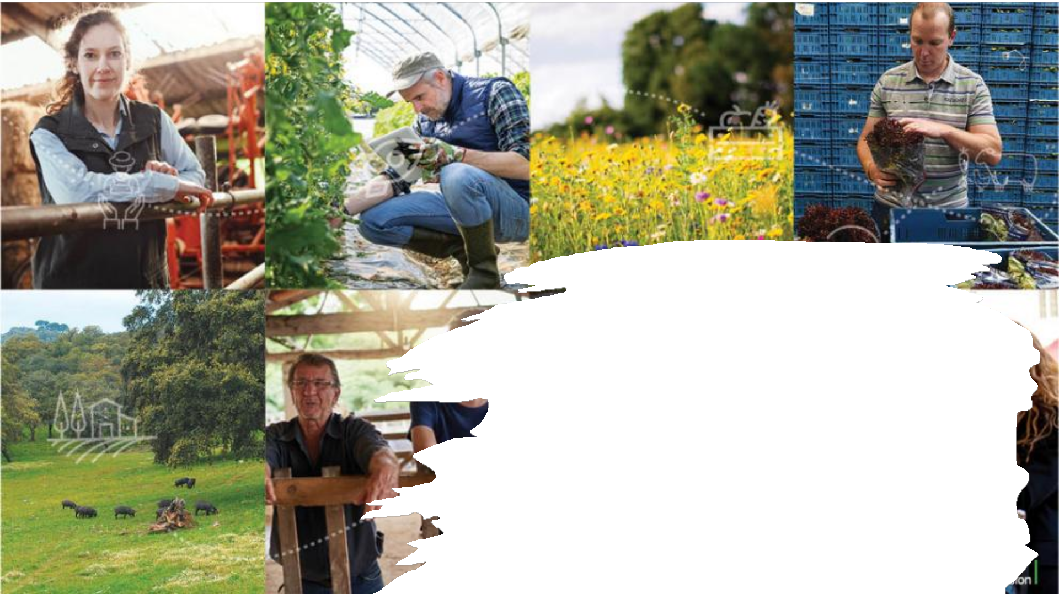
The common agricultural policy: 2023-27
Prof. Edgar J. SAUCEDO-ACOSTA
esaucedo@uv.mx
October 2026

Slide 2
The common agricultural policy: 2023-27
The common agricultural policy (CAP) is key:
  to securing the future of agriculture and forestry
  achieving the objectives of the European Green Deal.
On 2 December, 2021, the agreement on reform of the CAP was formally adopted.
The new legislation, which entered into force on 1 January 2023, paves the way for a fairer, greener and more performance-based CAP.

Slide 3
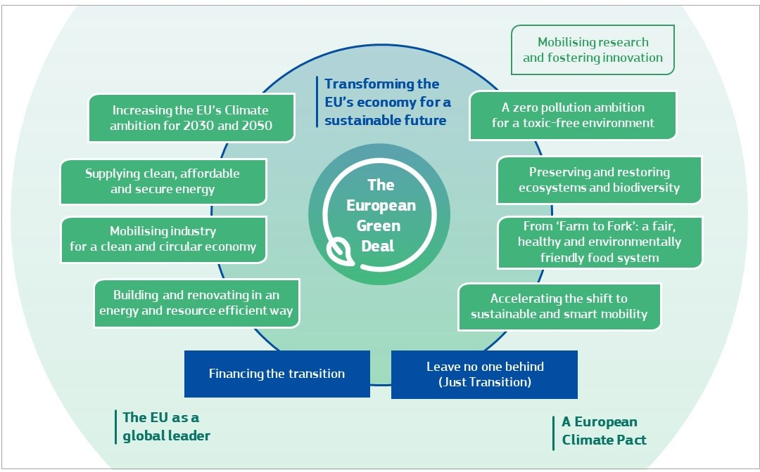

Slide 4
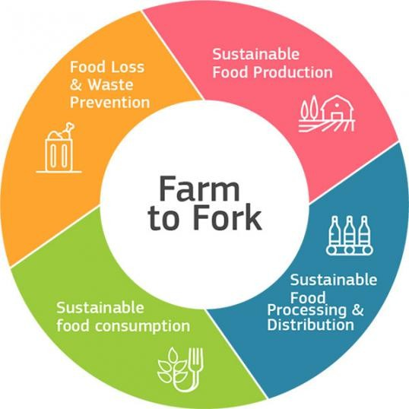
CAP seeks to ensure:
  a sustainable future for European farmers,
  provide more targeted support to smaller farms,
  and allow greater flexibility for EU countries to adapt measures to local conditions.
Agriculture and rural areas are central to the European Green Deal,
The CAP 2023-27 will be a key tool in reaching the ambitions of the Farm to Fork and biodiversity strategies.

Slide 5
A new way of working
The CAP 2023-27 is a modernized policy, with a strong emphasis on results and performance.
CAP Strategic Plans encourage the transition towards: (i) a smart, sustainable, competitive, resilient and diversified agricultural sector, while; (ii) ensuring long-term food security.

Slide 6
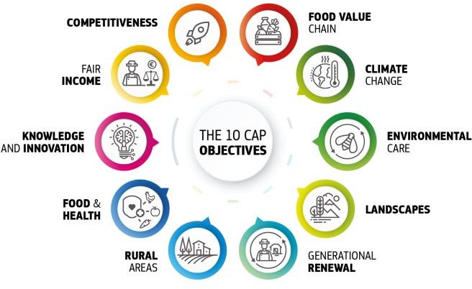
Ten specific objectives
The policy focuses on ten specific objectives, linked to common EU goals for social, environmental, and economic sustainability in agriculture and rural areas.

Slide 7
National strategic plans
Each EU country designed a national CAP Strategic Plan, combining funding for:
  income support,
  rural development,
  and market measures.
When designing their strategic plans, EU countries contributed to the ten specific objectives through a toolbox of broad policy measures provided by the Commission, which could be shaped around national needs and capabilities.

Slide 8
Focus on performance and results
CAP legislation lays down a common set of indicators as part of a new performance, monitoring and evaluation framework.
The indicators will be monitored through annual performance reports and a biannual review of the performance of CAP Strategic Plans to assess the progress of EU countries in reaching their targets and the objectives of the CAP.

Slide 9

Key areas of reform
The CAP 2023-27 contains a number of policy reforms to support the transition towards sustainable agriculture and forestry in the EU.

Slide 10






A greener CAP
The CAP 2023-27 supports agriculture in making a much stronger contribution to the goals of the European Green Deal:
Higher green ambitions
Contribute to the Green Deal targets
Enhanced conditionality
Eco.-schemes
Rural development
Operational programs
Climate and biodiversity

Slide 11
Higher green ambitions:
CAP plans are in line with environmental and climate legislation.
In its CAP strategic plan, each EU country is obliged to display a higher ambition on environment and climate action compared to the previous programming period (no “backsliding”) and is required to update the plan when climate and environmental legislation is modified;
Contribute to the Green Deal targets:
the national CAP Strategic Plans contribute to the Green Deal targets (the CAP recommendations set out how this contribution is expected);

Slide 12
Enhanced conditionality:
beneficiaries of the CAP have their payments linked to a stronger set of mandatory requirements.
For example, on every farm at least 3% of arable land is dedicated to biodiversity and non-productive elements, with a possibility to receive support via eco-schemes to achieve 7%. Wetlands and peatlands are also protected.
Eco-schemes:
at least 25% of the budget for direct payments is allocated to eco- schemes, providing stronger incentives for climate-and environment- friendly farming practices and approaches (such as organic farming, agro-ecology, carbon farming, etc.) as well as animal welfare improvements;

Slide 13
Rural development:
at least 35% of funds are allocated to measures to support climate, biodiversity, environment and animal welfare;
Operational programmes:
in the fruit and vegetables sector, operational programmes allocate
at least 15% of their expenditure towards the environment;
Climate and biodiversity:
40% of the CAP budget has to be climate-relevant and strongly support the general commitment to dedicate 10% of the EU budget to biodiversity objectives by the end of the EU's multiannual financial framework (MFF) period.

Slide 14




A fairer CAP
The CAP 2023-27 directs support to those who need it most:
Redistribution of income support
Active farmers
Social conditionality
Convergence of payments
Supporting young farmers
improving the gender balance

Slide 15
Redistribution of income support:
EU countries have to dedicate at least 10% of their direct payments to the redistributive income support tool, to better address the income needs of smaller and medium-sized farms;
Active farmers:
the new legislation contains a mandatory but flexible definition of an active farmer to be established by EU countries, including the level of activities undertaken.
Only active farmers may receive certain EU support;
Social conditionality:
CAP payments are linked to the respect of certain EU labour standards and beneficiaries are incentivised to improve working conditions on farms;

Slide 16
Convergence of payments:
in the CAP 2023-27 levels of income support converge more, both within individual EU countries and between EU countries;
Supporting young farmers:
EU countries have to distribute at least 3% of their direct payments budget towards young farmers, in the form of income or investment support, or start-up aid for young farmers;
Improving the gender balance:
gender equality and increasing the participation of women in farming are – for the first time – part of the objectives for CAP Strategic Plans. EU countries must assess these issues and address the identified challenges.

Slide 17
Improving competitiveness
The CAP 2023-27 will strengthen the position of farmers in the supply chain and
boost the competitiveness of the agri-food sector:
Improved bargaining power: new rules reinforce producer cooperation, encouraging farmers to work together and enabling them to create countervailing power in the market;
Market orientation: the CAP 2023-27 maintains the overall market orientation from the previous reforms, encouraging EU farms to align supply with demand in Europe and beyond;
Crisis reserve: to cope with future crises, the reformed CAP includes a new financial reserve amounting to at least €450 million per year;
Support for the wine sector: specific rules have been agreed to improve support for the wine sector.

Slide 18

A strong budget
The CAP will continue to benefit from a robust long-term budget.
Common agricultural policy funds
The CAP is supported by two funds drawn from the long-term budget of the EU – the European agricultural guarantee fund and the European agricultural fund for rural development.
CAP in the EU budget
European agricultural guarantee fund (EAGF)
European agricultural fund for rural development (EAFRD)

Slide 19
CAP in the EU budget
The total allocation for the CAP amounts to €386.6 billion, divided between two funds (often referred to as the “two pillars” of the CAP):
European agricultural guarantee fund (EAGF)
The EAGF (the “first pillar” of the CAP) has an allocation of €291.1 billion. Up to
€270 billion will be provided for income support schemes, with the remainder
dedicated to supporting agricultural markets.
European agricultural fund for rural development (EAFRD)
For the EAFRD (the CAP’s “second pillar”), the total allocation amounts to €95.5 billion. This includes €8.1 billion from the next generation EU recovery
instrument to help address the challenges posed by the COVID-19 pandemic.
Around 30% of the recovery funds will become available in 2021, with the
remaining 70% to be released in 2022.

Slide 20
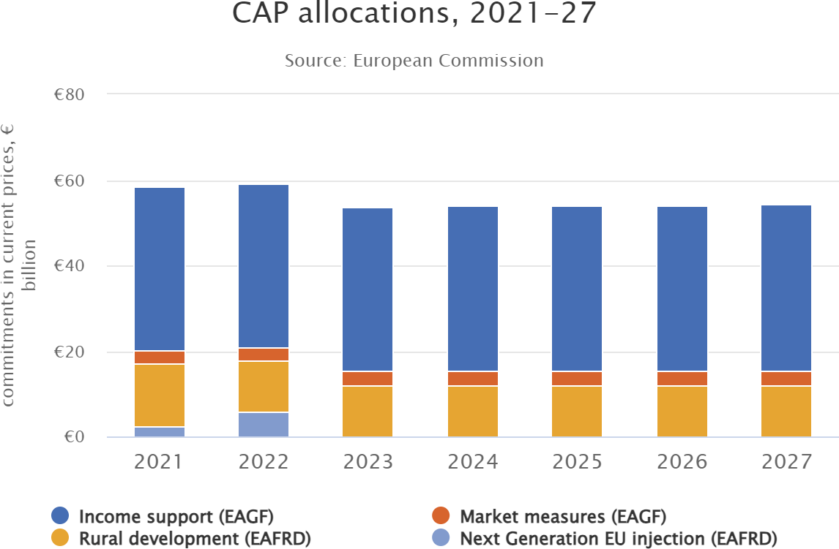

Slide 21
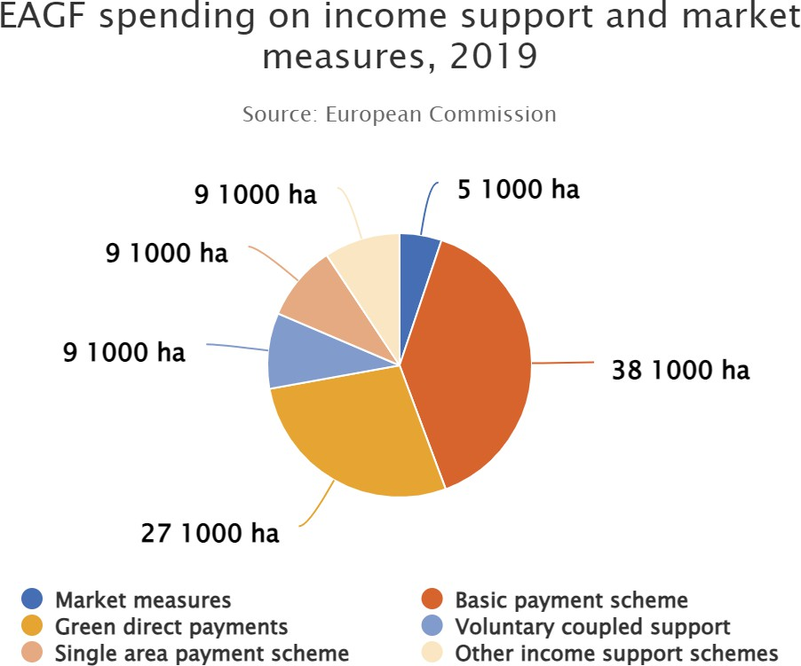
European agricultural guarantee fund
The EAGF primarily finances income support for farmers and market measures. In 2019, spending in these areas amounted to €43.81 billion.

Slide 22
Next Generation EU
This is more than a recovery plan. It is a once in a lifetime chance to emerge stronger from the pandemic, transform our economies, create opportunities and jobs for the Europe where we want to live. We have everything to make this happen.
The budget for the EAFRD includes €8 billion from Next Generation EU to help rural areas make the structural changes necessary to achieve the goals of the European Green Deal and the digital transition.

Slide 23






The largest stimulus package ever
A total of €2.018 trillion in current prices are helping rebuild a post-COVID-19 Europe. It will be a greener, more digital and more resilient Europe.
Main elements of the package
More than 50% of the long-term budget and Next Generation EU are supporting modernization, for example through:
Fair climate and digital transitions, via the Just Transition Fund and the Digital Europe Programme
Research and innovation, via Horizon Europe.
Preparedness, recovery and resilience, via the Recovery and Resilience Facility, rescEU and a new health programme, EU4Health
Modernising traditional policies such as cohesion and the common agricultural policy, to maximise their contribution to the Union's priorities
Fighting climate change, with 30% of the EU funds, the highest share ever of the European budget
Biodiversity protection and gender equality

Slide 24
Transfers between allocations
To allow EU countries to better adapt the policy to their farming sectors’ priorities, they are entitled to transfer up to 25% of their CAP allocations between income support and rural development.
EU countries can apply additional flexibilities for certain purposes, such as supporting environment and climate objectives, supporting young farmers and where countries have below-average direct payments.

Slide 25



Knowledge, research and innovation
Advancing research, knowledge-sharing, and innovation is essential for securing a smart and sustainable agricultural sector.
As part of its commitment to support research and innovation in agriculture, the Commission has proposed to set aside €10 billion from the Horizon Europe programme for projects relating to food, farming, rural development and the bioeconomy.
The reformed CAP benefits from this increased investment, incorporating stronger agricultural knowledge and innovation systems (AKIS) to boost the development of innovation projects, disseminate their results, and encourage their use as widely as possible. Farm advisory services are a key tool in sharing new knowledge and ideas.

Slide 26






CAP reform timeline
The European Parliament and Council of the EU agreed on their respective negotiating positions in October 2020, enabling the first “trilogue” between the three institutions to take place on 10 November.
November 2020
the agreement on reform of the CAP was formally adopted. By 31 December 2021 each EU country was required to submit its CAP Strategic Plan. The Commission had six months to assess and approve the plans.
the European Commission will submit a report to assess the joint effort of all CAP Strategic Plans, with a particular focus on the collective ambition to achieve Green Deal targets.
The Commission will undertake a first performance review of each CAP strategic plan and request - if necessary - specific follow-up actions to EU countries
The Commission will undertake a second performance review of each CAP Strategic Plan.
December 2021
Decembre 2023
2025
2027
June 2018
June 2021
2024
2026
On 1 June 2018, the European Commission presented legislative proposals for the reform of the CAP.
Following a series of
January 2023
As of 2024, each EU
In 2026, an interim
trilogues, a provisional political agreement on the CAP reform was reached on 25 June 2021.
country will present an annual performance report and hold an annual review meeting with the Commission.
evaluation will assess the performance of the CAP 2023-27
CAP Strategic Plans begin.

Slide 27
References
The common agricultural policy:2023-2027
https://agriculture.ec.europa.eu/common-agricultural-policy/cap- overview/cap-2023-27_en#anewwayofworking

