Slide 1

Elaboration of Scientific Research Papers
September 2026
Edgar J. Saucedo-Acosta
esaucedo@uv.mx

Slide 2
Lecture 3: Argument
Edgar J. Saucedo -Acosta
esaucedo@uv.mx
Universidad Veracruzana

Slide 3
Common reasons why Journals reject articles
Too Narrow or Too Broad
  A narrow…will not interest enough readers
  A broad…will see unnecessary to readers
Off Topic
  Editor: “inappropriate subject matter”
Not Scholarly
  Absence of reference to literature in your field
  Error in documentation: misspelled author name, unintentionally plagiarizing
Too Defensive
  Students…tend to overemphasize apparatus and underemphasize their content.

Slide 4
Common reasons why Journals reject articles
Not Sufficiently Original
  Most common reason editors…rejecting an article…is “ no new knowledge”
  Tell the reader what is new about your evidence, methodology, analysis or theories
Poor Structure
  Sign of poor structural faults are…irrelevant or redundant sections
Not Significant
  So what?
Theoretically or Methodology Flawed
  Has a poor conceptual design, an argument not supported by the data
Too many Misspellings and Grammatical Errors
  Coup de grace

Slide 5
Main reason Journal articles are rejected: No Argument
is because authors do not have an argument or do not state it early and clearly.
part of the reason that unclear arguments are so common in academia is because of the teach what argument is.

Slide 6
Making a good Argument
What is an Argument?
An argument is a discourse intended to persuade.
Your paper persuade someone by attract their doubts and providing evidence to overcome those doubts.
A Social Science article sets out to persuade the reader that the hypothesis is true or false. In such articles, what I am calling an argument is often described as the conclusion.

Slide 7
Making a good Argument
If the hypothesis is “does X affect y”…and argument is “ x affects y when z is present”.
Argument is a coherent series of statements in which the author leads the reader from certain premises to a particular conclusion.
Easiest way to distinguish whether a statement is an argument is if it consists of statement to which you can coherently respond “I agree” or “I disagree”.
Argument: an idea you must support with proofs to persuade the reader.

Slide 8
Making a good Argument
To construct an…argument, build in a consideration of opposing voices.
Why I include arguments that weaken my own position?
If you ignore research that conflicts with your claims, you assume that reader will not know that research
Your argument is less persuasive if you don’t address possible rebuttals.
In SS…often shows in the authors description of the limitations of the study.

Slide 9
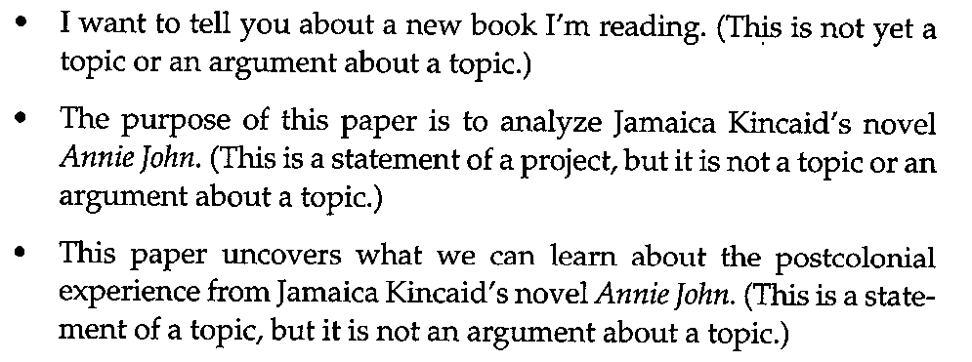
Making a good Argument
How to avoid making topics rather than arguments: An argument is not a topic.

Slide 10
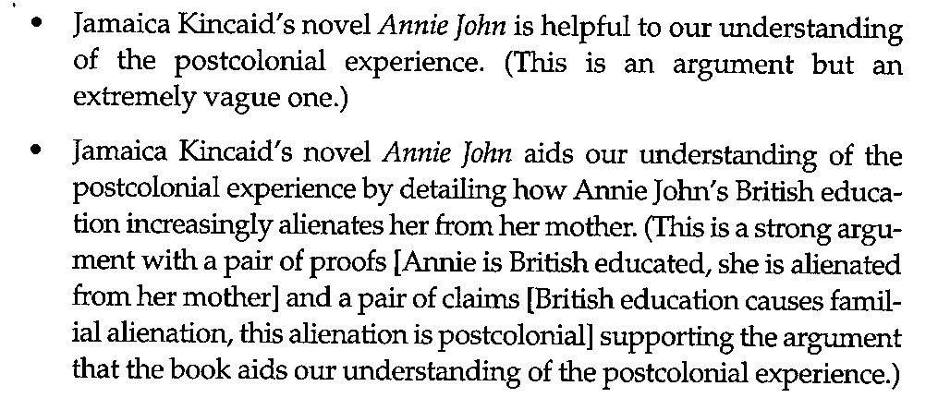
Making a good Argument

Slide 11
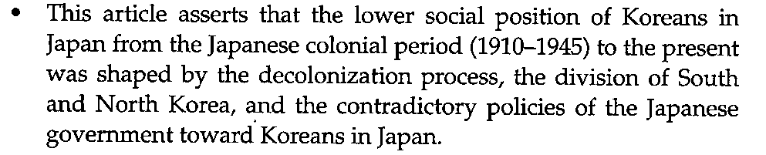
Making a good Argument
Is not an argument
Argument:

Slide 12
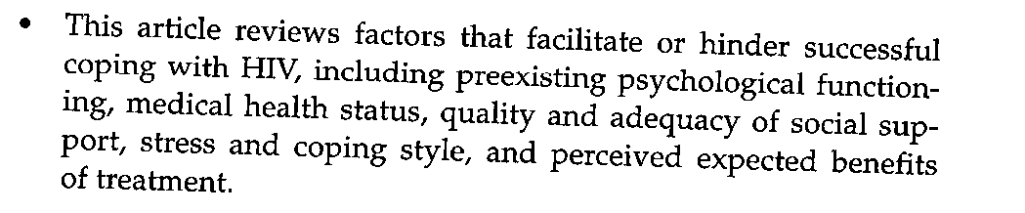
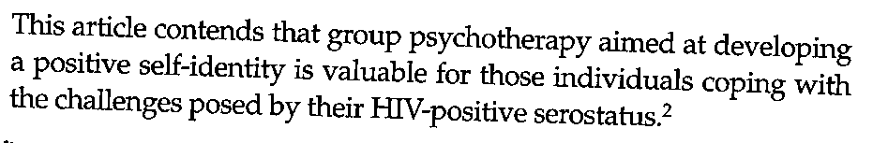
Is not an argument: “I agree” or “I disagree”?
Argument:

Slide 13
Making a good Argument
How to write an Argument-Driven Article
  Don’t fall into the trap of letting your data organize your article rather than your argument.
  Writing a journal article…they should not write like detective collecting data but like lawyer arguing a case
How to avoid a data-Driven Article
  An article is for using data to make an argument. Data must be subordinated.
  An article purpose is to argue not advise
  You are no telling the reader what to do about the problem, you are telling the reader what to think about the problem.

Slide 14
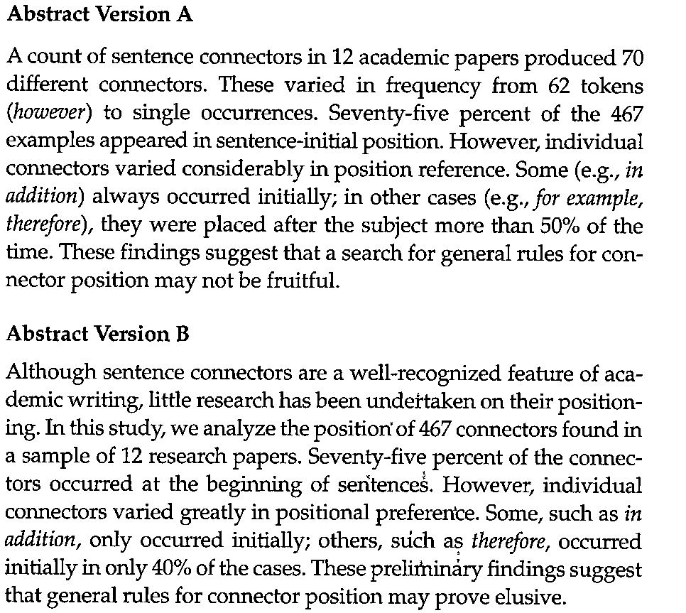

Slide 15
Argument
B is stronger:
  well organized, announcing its topic and significance in the first sentence.
  Its method in the second sentence
  Its findings in the three following sentences
  And concludes with argument that sentence connectors likely do not have general rules.
A is not well organized: providing no context, unexplained data, and unconnected argument. It is data-driven abstract.

Slide 16
Making a good Argument
One Argument Formula:
  One tool Posusta provides i something…helpful in teaching students about argument.

Slide 17
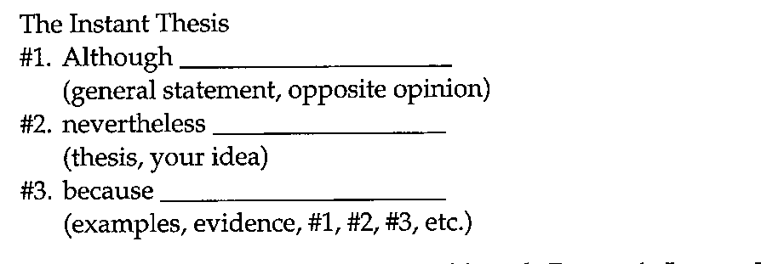
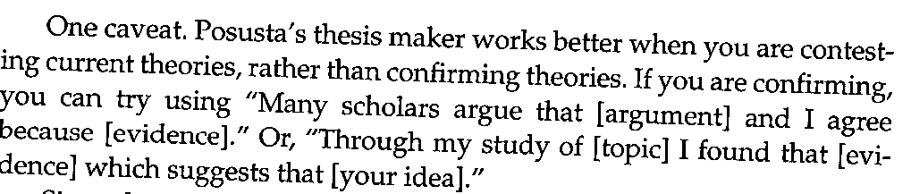

Slide 18
Thank you

