Slide 1
Chapter Six

Slide 2
Introduction
Car loans, home mortgages, and even credit card balances all create a loan from a financial intermediary - just like government and corporate bonds.
Virtually any financial arrangement involving the current transfer of resources from a lender to a borrower, with a transfer back in the future, is a form of a bond.
This free flow of resources through bond markets is essential to a well functioning economy.

Slide 3
Introduction
Alexander Hamilton, the first Secretary of the US Treasury, brought bonds to the U.S.
One of his first acts was to consolidate all debt from the Revolutionary War resulting in the first U.S. government bonds.
Many features of original bonds are the same, even with a more complex bond market.

Slide 4
Goals of the Chapter
To understand the financial system, particularly the bond market, we must:
Understand the relationship between bond prices and interest rates,
Understand that supply and demand in the bond market determine bond prices, and
Understand why bonds are risky.

Slide 5
Bond Prices
A standard bond specifies the fixed amounts to be paid and the exact dates of the payments.
How much should you be willing to pay for a bond?
That depends on the bond characteristics.
We will examine four basic types.

Slide 6
Bond Prices
1. Zero-coupon or discount bond
Promise a single payment on a future date
Example: Treasury bill
2. Fixed-payment loan
Sequence of fixed payments
Example: Mortgage or car loan
3. Coupon bond
periodic interest payments + principal repayment at maturity
Example: U.S. Treasury Bonds and most corporate bonds
4. Consol
periodic interest payments forever, principal never repaid
Example: U.K. government has some outstanding

Slide 7
Zero-Coupon Bonds
U.S. Treasury bills (T-bills) are the most straightforward type of bond.
Each T-bill represents a promise by the U.S. government to pay $100 on a fixed future date.
No coupon payments - zero-coupon bonds
Also called pure discount bonds (or discount bonds) since the price is less than face value - they sell at a discount.
Price of $100 face value zero-coupon bond

Slide 8
Zero-Coupon Bonds
Assume i = 5%
Price of a One-Year Treasury Bill
Price of a Six-Month Treasury Bill

Slide 9
Zero-Coupon Bonds
For a zero-coupon bond, the relationship between the price and the interest rate is the same as we saw on present value calculations.
When the price moves, the interest rate moves with it, in the opposite direction.
We can compute the interest rate from the price using the present value formula.
The price of a one-year T-bill is $95.
i = ($100/$95) - 1 = 0.0526 = 5.26%

Slide 10
Fixed-Payment Loans
Home mortgages and car loans are fixed-payment loans.
They promise a fixed number of equal payments at regular intervals.
Amortized loans - the borrower pays off part of the principal along with the interest for the life of the loan.
Value of a Fixed Payment Loan =
The sum of the present value of the payments.

Slide 11
Coupon Bonds
The issuer of a coupon bond promises to make a series of periodic interest payments (coupon payments), plus a principal payment at maturity.
Price of Coupon Bond =

Slide 12
There are two basic types of mortgages:
Conventional fixed-rate, and
Adjustable-rate, ARMs.
Fixed-rate mortgages are easy but ARMs can be complicated.
The interest rate changes so payments change.
Choosing this means one should know about interest-rate indexes, margins, discounts, caps, negative amortization, and convertibility.
Read the list of questions to know - a mortgage might be the most important financial decision most people make.

Slide 13
Consols
Consols or perpetuities, are like coupon bonds whose payments last forever.
The borrower pays only interest, never repaying the principal.
The U.S. government sold consols once in 1900, but the Treasury has bought them all back.
The price of a consol is the present value of all future interest payments.

Slide 14
Bond Yields
We know how to calculate bond prices given an interest rate.
We also need to be able to go in the other direction.
Calculate the return to an investment, implicit in the bond’s price.
We will combine information about the promised payments with the price to obtain the yield:
A measure of the cost of borrowing and the reward for lending.
We will use the terms yield and interest rate interchangeably.

Slide 15
Yield to Maturity
The most useful measure of the return on holding a bond is called the yield to maturity:
The yield bondholders receive if they hold the bond to its maturity when the final principal payment is made.
Price of 1yr 5% Coupon Bond =
The value of i that solves the equation is the yield to maturity.

Slide 16
Yield to Maturity
If Bond Price = $100, Yield to maturity = the coupon rate
If Bond Price > $100, Yield to maturity < the coupon rate
If Bond Price < $100, Yield to maturity > the coupon rate Bond Price ↑ ⇒ Yield to maturity ↓

Slide 17
Yield to Maturity
This relationship should make sense.
If you pay $95 for a $100 face value bond, you will receive both the interest payments and the increase in value from $95 to $100.
This rise in value is referred to as a capital gain and is part of the return on your investment.
When the price of a bond is higher than face value, the bondholder incurs a capital loss.

Slide 18
Current Yield
Current yield is the measure of the proceeds the bondholder receives for making a loan.
The current yield measures that part of the return from buying the bond that arises solely from the coupon payments.
If the price is below par, the current yield will be below the yield to maturity.

Slide 19
Current Yield
Example:
1 year, 5% coupon bond selling for $99
Current Yield = , or 5.05%
Yield to maturity for this bond is 6.06 percent found as the solution to:

Slide 20
Current Yield
We can see the relationship between the current yield and the coupon rate.
Table 6.1 summarizes these relationships.

Slide 21
Holding Period Returns
The holding period return is the return to holding a bond and selling it before maturity.
The holding period return can differ from the yield to maturity.

Slide 22
Holding Period Returns
Examples:
10 year bond
6% coupon rate
Purchase at face value, $100
Hold for one year and then sell it

Slide 23
Holding Period Returns
What if the interest rate falls to 5%?
1yr Holding Period Return =
1-yr Holding Period Return = 13.11%

Slide 24
Holding Period Returns
What if the interest rate rises to 7%?
1yr Holding Period Return =
1-yr Holding Period Return = −0.52%

Slide 25
Holding Period Returns
The one-year holding period return is the sum of the yearly coupon payment divided by the price paid for the bond and the change in the price divided by the price paid.
= Current Yield + Capital Gain (as a %)

Slide 26
Holding Period Returns
Whenever the price of a bond changes, there is a capital gain or loss.
The greater the price change, the more important that part of the holding period return becomes.
The longer the term of the bond, the greater those price movements and associated risk can be.

Slide 27
The Bond Market and the Determination of Interest Rates
How are bond prices determined and why do they change?
We must look at bond supply, bond demand, and equilibrium prices.
First we will restrict discussion to the quantity of bonds outstanding - stock of bonds.
Secondly, we will talk about bond prices rather than interest rates.
Finally, we will consider the market for a one-year zero-coupon bond with a face value of $100.

Slide 28
The Bond Market and the Determination of Interest Rates
Assume an investor is planning to purchase a one-year bond and hold until maturity.
They have a one-year investment horizon.
The holding period return equals the bond’s yield to maturity - both determined directly from price.
The present value formula shows the relationship between price and yield as:

Slide 29
Everyday the Wall Street Journal lists the previous day’s closing yields for a wide variety of bonds that serve as benchmarks.
Table 6.2 - Global Government Bonds and 6.3 - Corporate Bonds show some of this information.
Table 6.2 shows yields and spreads over or under US Treasury bonds.
Table 6.3 shows one day changes of yield spreads compared to similar-maturity US treasury yields.

Slide 30
Bond Supply, Bond Demand and Equilibrium in the Bond Market
Supply and demand determine bond prices (and bond yields).
The bond supply curve is the relationship between the price and the quantity of bonds people are willing to sell, all else equal.
The higher the price of a bond, the larger the quantity supplied.
The bond supply curve slopes upward.
Why?

Slide 31
Bond Supply, Bond Demand and Equilibrium in the Bond Market
Investor:
The higher the price, the more tempting it is to sell a bond they currently hold.
Company seeking to finance a project:
The higher the price at which they can sell bonds, the cheaper it is to borrow.
For a $100 one-year zero-coupon bond, the supply will be higher at $95 than it will be at $90, all other things being equal.

Slide 32
Bond Supply, Bond Demand and Equilibrium in the Bond Market
The bond demand curve is the relationship between the price and the quantity of bonds that investors demand, all else equal.
The price of bonds is inversely related to the yield, the demand curve implies that the higher the demand for bonds, the higher the yield.
The bond demand curve slopes downward.
Why?

Slide 33
Bond Supply, Bond Demand and Equilibrium in the Bond Market
Investors:
The lower the price bondholders must pay for a fixed-dollar payment on a future date, the more likely they are to buy a bond.
For a $100 one-year zero-coupon bond, the demand will be higher at $90 than it will be at $95, all other things being equal.

Slide 34
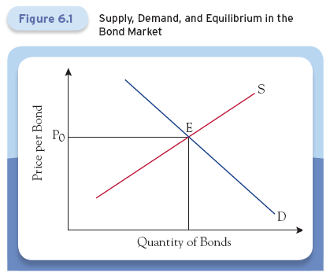
Bond Supply, Bond Demand and Equilibrium in the Bond Market
Equilibrium is the point at which supply equals demand.

Slide 35
Bond Supply, Bond Demand and Equilibrium in the Bond Market
What if bond prices are above equilibrium?
Quantity supplied > quantity demanded.
With excess supply, supplier cannot sell bonds they want at current price.
Suppliers begin to cut the price.
Excess supply puts downward pressure on the price until supply equals demand.

Slide 36
Bond Supply, Bond Demand and Equilibrium in the Bond Market
What if the price is below equilibrium?
Those who wish to buy bonds cannot get what they want at that price.
They start bidding up the price.
Excess demand puts upward pressure on the price until supply equals demand.

Slide 37
Bond Supply, Bond Demand and Equilibrium in the Bond Market
To understand bond prices, we really need to understand what determines supply and demand.
Remember the distinction between moving along a curve (change in quantity supplied or demanded) versus a shift in the curve (change in supply or demand).
A shift in either supply or demand changes the price of bonds, so it changes yields as well.

Slide 38
Factors That Shift Bond Supply
Changes in Government Borrowing
Any increase in the government’s borrowing needs increases the quantity of bonds outstanding, shifting the bond supply curve to the right.
Change in General Business Conditions
As business conditions improve, the bond supply curve shifts to the right.
Changes in Expected Inflation
When expected inflation rises, the cost of borrowing falls, shifting the bond supply curve to the right.

Slide 39
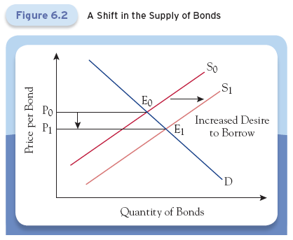
Factors That Shift Bond Supply
When borrowers’ desire for funds increases, the supply curve shifts to the right.
This lowers bond prices, raising interest rates.

Slide 40
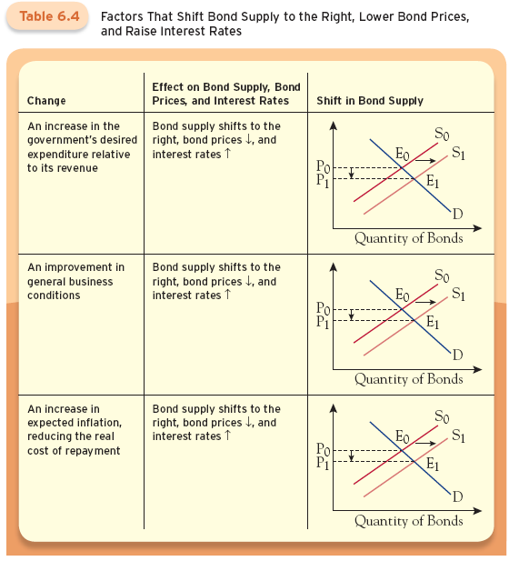

Slide 41
Factors That Shift Bond Demand
Wealth
Increases in wealth shift the demand for bonds to the right.
Expected Inflation
Declining inflation means promised payments have higher value - bond demand shifts right.
Expected Returns and Expected Interest Rates
If the return on bonds rises relative to the return on alternative investments, bond demand will shift right.
When interest rates are expected to fall, price prices are expected to rise shifting bond demand to the right.

Slide 42
Factors That Shift Bond Demand
Risk Relative to Alternatives
If bonds become less risky relative to alternative investments, demand for bonds shifts right.
Liquidity Relative to Alternatives
Investors like liquidity: the more liquid the bond, the higher the demand.
If bonds become less risky relative to alternative investments, demand for bonds shifts right.

Slide 43
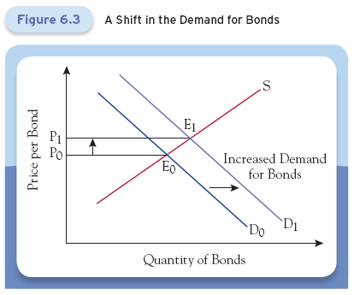
Factors That Shift Bond Demand
When bonds become more attractive for investors, the demand curve shifts to the right.
This raises bond prices, lowering interest rates.

Slide 44
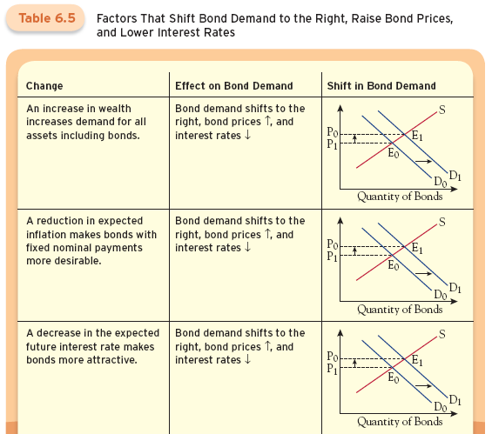
Factors That Shift Bond Demand

Slide 45
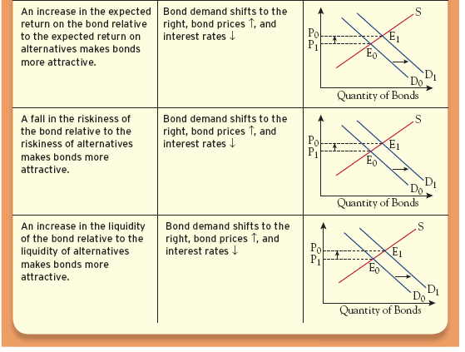
Factors That Shift Bond Demand

Slide 46
You notice in the newspaper a company advertising that their bond mutual funds returned 13.5% last year.
You remember interest rates being fairly low and the paper backs that up.
How is the ad correct?
The ad is talking about last year’s returns, when interest rates were falling.
When an ad states at the bottom that “Past Performance is No Indication of Future Returns” you should take it seriously.

Slide 47
Understanding Changes in Equilibrium Bond Prices and Interest Rates
Recall that expected inflation affects both bond supply and bond demand.
Increasing expected inflation
Reduces the real cost of borrowing shifting bond supply to the right.
But, lowers real return on lending, shifting bond demand to the left.

Slide 48
Understanding Changes in Equilibrium Bond Prices and Interest Rates
S₀
1) Shift S right
S₁
2) Shift D right
E₀
These two effects reinforce each other.
Lower bond prices
Raise interest rates
Price per Bond
E₁
However, graphically unknown effect on quantity of bonds.
D₀
D₁
Quantity of Bonds

Slide 49
Understanding Changes in Equilibrium Bond Prices and Interest Rates
A business cycle downturn:
Reduces business investment opportunities shifting bond supply to the left.
Reduces wealth, shifting bond demand to the left also.
Although both shifts could give an ambiguous answer in terms of bond price, theory is not ambiguous.
In recessions, interest rates tend to fall meaning that bond prices should rise.

Slide 50
Understanding Changes in Equilibrium Bond Prices and Interest Rates
S₁
Shift S left
Shift D left
S₀
E₁
We know price increases so supply shifts more than demand.
Price per Bond
E₀
D₀
D₁
Quantity of Bonds

Slide 51
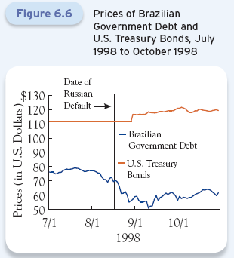
Investors’ concerns about risk affect their demand for U.S. Treasuries.
1998, Russia defaulted and people lost confidence in emerging market countries.
Safest assets are U.S. Treasuries.
Demand increased, price increased, and yields declined.

Slide 52
Why Bonds are Risky
Bondholders face three major risks.
Default risk is the chance that the bond’s issuer may fail to make the promised payment.
Inflation risk means investors can’t be sure of what the real value of payments will be.
Interest-rate risk arises from a bond-holder’s investment horizon, which may be shorter than the maturity date of the bond.

Slide 53
Why Bonds are Risky
Risk arises because an investment has many possible payoffs during the holding horizon.
We need to look at the risk the bondholder faces, what are the possible payoffs, and how likely each is to occur.
We will compare the risk on a bond’s return relative to the risk-free rate.

Slide 54
Default Risk
Although there is little to no default risk with U.S. Treasury bonds, there is with corporate bonds.
In determining what happens to bond prices when we consider default risk, we can look at an example of a corporate bond.
Assume the one-year risk-free interest rate is 5 percent.
A company has issued a 5 percent coupon bond with a face value of $100.

Slide 55
Default Risk
If this bond was risk-free, the price of the bond would be the present value of the $105 payment.
Price of risk free bond = ($100 + $5)/$1.05 = $100
Suppose, however, there is a 10% probability that the company will go bankrupt before paying back the loan.
Assume the outcome is either $105 or $0.
Expected value equals $94.50
Price of bond = $94.50/1.05 = $90

Slide 56
Default Risk
If the price of the bond is $90, what yield to maturity does this price imply?
Promised yield on bond = $105/$90 - 1 = 0.1667
Since the default risk premium is the promised yield to maturity minus the risk-free rate:
= 16.67 percent - 5 percent = 11.67 percent.
Any risk premium will drive the price below $90 and push the yield to maturity above 16.67 percent.
The higher the default risk, the higher the yield.

Slide 57
Securitization is the process by which financial institutions pool various assets (such as residential mortgages) that generate a stream of payments and transform them into a bond that gives the bondholder a claim to those payments (instead of fixed coupons).
Securitization has grown and now encompasses more than half of the U.S. mortgages.

Slide 58
Securitization uses the efficiency of markets to lower the cost of borrowing by:
Facilitating diversification of risks,
Making assets liquid,
Allowing greater specialization in the business of finance,
Broadening markets, and
Fostering innovations.

Slide 59
Inflation-indexed bonds are structured so that the government promises to pay you a fixed interest rate plus the change in the consumer price index (CPI).
The U.S. Treasury sells two types of bonds that are guaranteed to beat inflation.
Series I savings bonds
Treasury Inflation Protection Securities (TIPS)

Slide 60
Inflation Risk
With few exceptions, bonds promise to make fixed-dollar payments.
Remember that we care about the purchasing power of our money, not the number of dollars.
This means bondholders care about the real interest rate.
How does inflation risk affect the interest rate?

Slide 61
Inflation Risk
Think of the interest rate having three components:
The real interest rate
Expected inflation, and
Compensation for inflation risk.
Example:
Real interest rate is 3 percent.
Inflation could be either 1 percent or 3 percent.
Expected inflation is 2 percent, with a standard deviation of 1.0 percent.

Slide 62
Inflation Risk
Nominal interest rate should equal
3 percent real interest rate +
2 percent expected inflation +
Compensation for inflation risk
The greater the inflation risk, the larger the compensation for it.

Slide 63
Interest-Rate Risk
Interest-rate risk arises from the fact that investors don’t know the holding period return of a long-term bond.
The longer the term of the bond, the larger the price change for a given change in the interest rate.
For investors with holding periods shorter than the maturity of the bond, the potential for a change in interest rates creates risk.
The more likely the interest rates are to change during the bondholder’s investment horizon, the larger the risk of holding a bond.

Slide 64
When the boom in house prices ended, holders of the private-label securities suffered large losses.
In the resulting financial crisis in 2007, private securitization of mortgages collapsed.
Although it has yet to rebound, some underwriters were seeing an opportunity to revive it.

Slide 65
End of
Chapter Six

