Slide 1
Chapter Three

Slide 2
Introduction
The international financial system exists to facilitate the design, sale, and exchange of a broad set of contracts with a very specific set of characteristics.
We obtain financial resources through this system:
Directly from markets, and
Indirectly through institutions.

Slide 3
Introduction
Indirect Finance: An institution stands between lender and borrower.
We get a loan from a bank or finance company to buy a car.
Direct Finance: Borrowers sell securities directly to lenders in the financial markets.
Direct finance provides financing for governments and corporations.
Asset: Something of value that you own.
Liability: Something you owe.

Slide 4
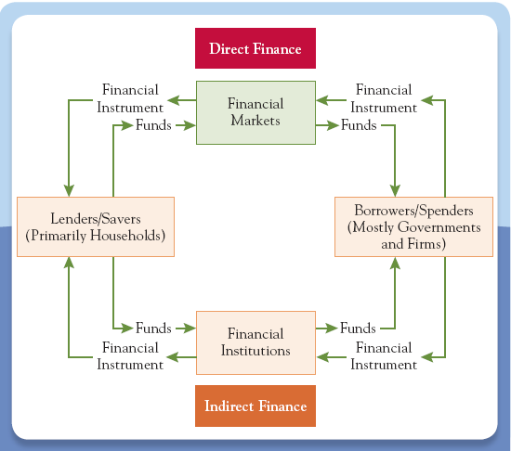
Figure 3.1: Funds Flowing through the Financial System

Slide 5
Introduction
Financial development is linked to economic growth.
The role of the financial system is to facilitate production, employment, and consumption.
Resources are funneled through the system so resources flow to their most efficient uses.

Slide 6
Introduction
We will survey the financial system in three steps:
Financial instruments or securities
Stocks, bonds, loans and insurance.
What is their role in our economy?
Financial Markets
New York Stock Exchange, Nasdaq.
Where investors trade financial instruments.
Financial institutions
What they are and what they do.

Slide 7
Financial Instruments
Financial Instruments: The written legal obligation of one party to transfer something of value, usually money, to another party at some future date, under certain conditions.
The enforceability of the obligation is important.
Financial instruments obligate one party (person, company, or government) to transfer something to another party.
Financial instruments specify payment will be made at some future date.
Financial instruments specify certain conditions under which a payment will be made.

Slide 8
Uses of Financial Instruments
Three functions:
Financial instruments act as a means of payment (like money).
Employees take stock options as payment for working.
Financial instruments act as stores of value (like money).
Financial instruments generate increases in wealth that are larger than from holding money.
Financial instruments can be used to transfer purchasing power into the future.
Financial instruments allow for the transfer of risk (unlike money).
Futures and insurance contracts allows one person to transfer risk to another.

Slide 9
The use of borrowing to finance part of an investment is called leverage.
Leverage played a key role in the financial crisis of 2007-2009.
How did this happen?
The more leverage, the greater the risk that an adverse surprise will lead to bankruptcy.
The more highly leveraged, the less net worth.

Slide 10
How did this happen? (cont.)
Some important financial institutions, during the crisis, were leveraged at more than 30 times their net worth.
When losses are experienced, firms try to deleverage to raise net worth.
When too many institutions deleverage, prices fall, losses increase, net worth falls more.
This is called the “paradox of leverage”.

Slide 11
The “paradox of leverage” reinforces the destabilizing liquidity spiral from Chapter 2.
Both spirals feed the cycle of falling prices and widespread deleveraging that was the hallmark of the financial crisis of 2007-2009.

Slide 12
Characteristics of Financial Instruments
These contracts are very complex.
This complexity is costly, and people do not want to bear these costs.
Standardization of financial instruments overcomes potential costs of complexity.
Most mortgages feature a standard application with standardized terms.

Slide 13
Characteristics of Financial Instruments
Financial instruments also communicate information, summarizing certain details about the issuer.
Continuous monitoring of an issuer is costly and difficult.
Mechanisms exist to reduce the cost of monitoring the behavior of counterparties.
A counterparty is the person or institution on the other side of the contract.

Slide 14
Characteristics of Financial Instruments
The solution to high cost of obtaining information is to standardize both the instrument and the information about the issuer.
Financial instruments are designed to handle the problem of asymmetric information.

Slide 15
Underlying Versus Derivative Instruments
Two fundamental classes of financial instruments.
Underlying instruments are used by savers/lenders to transfer resources directly to investors/borrowers.
This improves the efficient allocation of resources.
Examples: stocks and bonds.

Slide 16
Underlying Versus Derivative Instruments
Derivative instruments are those where their value and payoffs are “derived” from the behavior of the underlying instruments.
Examples are futures and options.
The primary use is to shift risk among investors.

Slide 17
A Primer for Valuing Financial Instruments
Four fundamental characteristics influence the value of a financial instrument:
Size of the payment:
Larger payment - more valuable.
Timing of payment:
Payment is sooner - more valuable.
Likelihood payment is made:
More likely to be made - more valuable.
Conditions under with payment is made:
Made when we need them - more valuable.

Slide 18
A Primer for Valuing Financial Instruments
We organize financial instruments by how they are used:
Primarily used as stores of value
Bank loans
Borrower obtains resources from a lender to be repaid in the future.
Bonds
A form of a loan issued by a corporation or government.
Can be bought and sold in financial markets.

Slide 19
A Primer for Valuing Financial Instruments
Home mortgages
Home buyers usually need to borrow using the home as collateral for the loan.
A specific asset the borrower pledges to protect the lender’s interests.
Stocks
The holder owns a small piece of the firm and entitled to part of its profits.
Firms sell stocks to raise money.
Primarily used as a stores of wealth.

Slide 20
A Primer for Valuing Financial Instruments
Asset-backed securities
Shares in the returns or payments arising from specific assets, such as home mortgages and student loans.
Mortgage backed securities bundle a large number of mortgages together into a pool in which shares are sold.
Securities backed by sub-prime mortgages played an important role in the financial crisis of 2007-2009.

Slide 21
A Primer for Valuing Financial Instruments
Primarily used to Transfer Risk
Insurance contracts.
Primary purpose is to assure that payments will be made under particular, and often rare, circumstances.
Futures contracts.
An agreement between two parties to exchange a fixed quantity of a commodity or an asset at a fixed price on a set future date.
A price is always specified.
This is a type of derivative instrument.

Slide 22
A Primer for Valuing Financial Instruments
Options
Derivative instruments whose prices are based on the value of an underlying asset.
Give the holder the right, not obligation, to buy or sell a fixed quantity of the asset at a pre-determined price on either a specific date or at any time during a specified period.
These offer an opportunity to store value and trade risk in almost any way one would like.

Slide 23
The biggest risk we all face is becoming disabled and losing our earning capacity.
Insuring against this should be one of our highest priorities.
More likely than our house burning down.
It is important to assess to make sure you have enough insurance.
One risk better transferred to someone else.

Slide 24
Financial Markets
Financial markets are places where financial instruments are bought and sold.
These markets are the economy’s central nervous system.
These markets enable both firms and individuals to find financing for their activities.
These markets promote economic efficiency:
They ensure resources are available to those who put them to their best use.
They keep transactions costs low.

Slide 25
The Role of Financial Markets
Liquidity:
Ensure owners can buy and sell financial instruments cheaply.
Keeps transactions costs low.
Information:
Pool and communication information about issuers of financial instruments.
Risk sharing:
Provide individuals a place to buy and sell risk.

Slide 26
The Structure of Financial Markets
Distinguish between markets where new financial instruments are sold and where they are resold or traded: primary or secondary markets.
Categorize by the way they trade: centralized exchange or not.
Group based on the type of instrument they trade: as a store of value or to transfer risk.

Slide 27
Primary versus Secondary Markets
A primary market is one in which a borrower obtains funds from a lender by selling newly issued securities.
Occurs out of the public views.
An investment bank determines the price, purchases the securities, and resells to clients.
This is called underwriting and is usually very profitable.

Slide 28
Primary versus Secondary Markets
Secondary financial markets are those where people can buy and sell existing securities.
Buying a share of IBM stock is not purchased from the company, but from another investor in a secondary market.
These are the prices we hear about in the news.

Slide 29
Centralized Exchanges, OTC’s, and ECN’s
Centralized exchanges - buyers and sellers meet in a central, physical location.
Over-the-counter markets (OTS’s) - decentralized markets where dealers stand ready to buy and sell securities electronically.
Electronic communication networks (ECN’s) - electronic system bringing buyers and sellers together without the use of a broker or dealer.

Slide 30
Centralized Exchanges, OTC’s, and ECN’s
History
The New York Stock Exchange (NYSE) is a place with an address where trading takes place in person on the floor of the exchange.
A firm purchases a license issued by the Exchange.
Others were acquired by specialists who oversaw the trading.

Slide 31
Centralized Exchanges, OTC’s, and ECN’s
History (cont.)
In the past, the only alternative was an OTC market.
Networks of physically dispersed dealers, who buy and sell electronically.
The largest is the Nasdaq.
In 2005, the NYSE merged with Archipelago (now NYSE Arca), and Nasdaq merged with Instinet.

Slide 32
Centralized Exchanges, OTC’s, and ECN’s
History (cont.)
Market continues to globalize.
In 2007, the NYSE merged with Paris-based Euronext becoming the first international operator of major exchanges.
Nasdaq attempted to acquire the London Stock Exchange but dropped its bid in 2007 right before the financial crisis.

Slide 33
Trading is what makes financial markets work.
Placing an order in a stock market has the following characteristics:
The stock you wish to trade.
Whether you wish to buy or sell.
The size of the order - number of shares.
The price you would like to trade.

Slide 34
You can place a market order.
Your order is executed at the most favorable price currently available.
Values speed over price.
You can place a limit order:
Places a maximum on the price to buy or a minimum price to sell.

Slide 35
Executing a trade requires someone on the other side.
Broker
Direct access to electronic trading network through an ECN like Acra or Instinet.
Customer orders interact automatically without an intermediary.
Liquidity is provided by customers.

Slide 36
For a well known stock, the NYSE is another place from which to order.
Liquidity is supplemented by designated market makers (DMMs).
The person on the floor charged with making a market.
To make the market work, they often buy and sell on their own account.

Slide 37
Debt and Equity versus Derivative Markets
Used to distinguish between markets where debt and equity are traded and those where derivative instruments are traded.
Equity markets are the markets for stocks.
Derivative markets are the markets where investors trade instruments like futures and options.

Slide 38
Debt and Equity versus Derivative Markets
In debt and equity markets, actual claims are bought and sold for immediate cash payments.
In derivative markets, investors make agreements that are settled later.
Debt instruments categorized by the loan’s maturity
Repaid in less than a year - traded in money markets.
Maturity of more than a year - traded in bond markets.

Slide 39
This article highlights large swings in financial markets during the financial crisis from 2007-2009.
Before the crisis, professional investors made their own institutions and the overall financial system vulnerable by taking on too much risk.
When the crisis hit, they faced a shortfall of liquidity.
Liquidity swings caused many financial markets to plunge and rebound together.

Slide 40
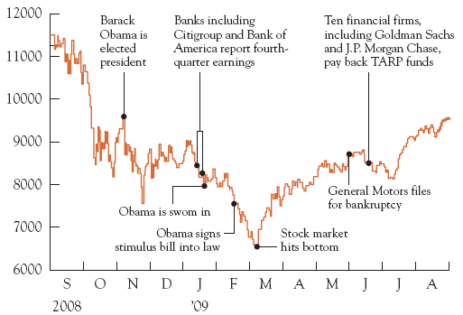

Slide 41
Characteristics of a Well-Run Financial Market
Essential characteristics of a well-run financial market:
Must be designed to keep transaction costs low.
Information the market pools and communicates must be accurate and widely available.
Borrowers promises to pay lenders much be credible.

Slide 42
Characteristics of a Well-Run Financial Market
Because of these criteria, the governments are an essential part of financial markets as they enforce the rules of the game.
Countries with better investor protections have bigger and deeper financial markets.

Slide 43
Liquid, interbank loans are the marginal source of funds for many banks, with their cost guiding other lending rates.
The financial crisis of 2007-2009 strained interbank lending.
Anxious banks preferred to hold their liquid assets in case their own needs arose.
They also were concerned about the safety of their trading partners.

Slide 44
The rising cost and reduced availability of interbank loans created a vicious circle of:
increased caution,
greater demand for liquid assets,
reduced willingness to lend, and
higher loan rates.

Slide 45
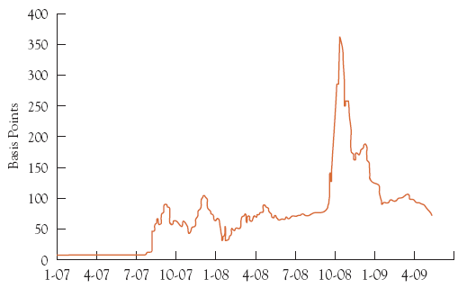

Slide 46
Financial Institutions
Firms that provide access to the financial markets, both
to savers who wish to purchase financial instruments directly and
to borrowers who want to issue them.
Also known as financial intermediaries.
Examples: banks, insurance companies, securities firms, and pension funds.
Healthy financial institutions open the flow of resources, increasing the system’s efficiency.

Slide 47
The Role of Financial Institutions
To reduce transaction costs by specializing in the issuance of standardized securities.
To reduce the information costs of screening and monitoring borrowers.
They curb asymmetries, helping resources flow to most productive uses.
To give savers ready access to their funds.

Slide 48
Financial intermediation and leverage in the US have shifted away from traditional banks and toward other financial institutions less subject to government regulations.
Brokerages, insurers, hedge funds, etc.
These have become known as shadow banks.
Provide services that compete with banks but do not accept deposits.
Take on more risk than traditional banks and are less transparent.

Slide 49
The rise of highly leveraged shadow banks, combined with government relaxation of rules for traditional banks, permitted a rise of leverage in the financial system as a whole.
This made the financial system more vulnerable to shocks.
Rapid growth in some financial instruments made it easier to conceal leverage and risk-taking.

Slide 50
The financial crisis transformed shadow banking.
The largest US brokerages failed, merged, or converted themselves into traditional banks to gain access to funding.
The crisis has encouraged the government to scrutinize any financial institution that could, by risk taking, pose a threat to the financial system.

Slide 51
The Structure of the Financial Industry
We can divide intermediaries into two broad categories:
Depository institutions,
Take deposits and make loans
What most people think of as banks
Non-depository institutions.
Include insurance companies, securities firms, mutual fund companies, etc.

Slide 52
The Structure of the Financial Industry
Depository institutions take deposits and make loans.
Insurance companies accept premiums, which they invest, in return for promising compensation to policy holders under certain events.
Pension funds invest individual and company contributions in stocks, bonds, and real estate in order to provide payments to retired workers.

Slide 53
The Structure of the Financial Industry
Securities firms include brokers, investment banks, underwriters, and mutual fund companies.
Brokers and investment banks issue stocks and bonds to corporate customers, trade them, and advise customers.
Mutual-fund companies pool the resources of individuals and companies and invest them in portfolios.
Hedge funds do the same for small groups of wealthy investors.

Slide 54
The Structure of the Financial Industry
Finance companies raise funds directly in the financial markets in order to make loans to individuals and firms.
Finance companies tend to specialize in particular types of loans, such as mortgage, automobile, or business equipment.

Slide 55
The Structure of the Financial Industry
Government-sponsored enterprises are federal credit agencies that provide loans directly for farmers and home mortgagors.
Guarantee programs that insure loans made by private lenders.
Provides retirement income and medical care through Social Security and Medicare.

Slide 56
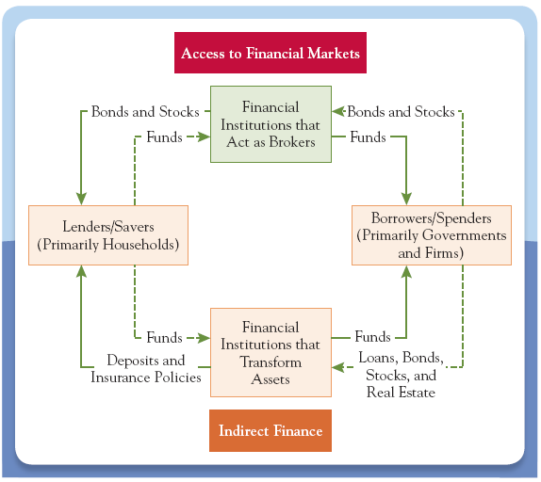
Figure 3.2: Flow of Funds through Financial Institutions

Slide 57
Most people need to borrow to buy a house.
Mortgage payment will be your biggest monthly expense so shop around.
Many offers are from mortgage brokers - firms that have access to pools of funds earmarked for use as mortgages.
Who offers your mortgage is not important - get the best rate you can.

Slide 58
End of Chapter Three

