Slide 1
Guide to action and non -action verbs
Teacher David presents:

Slide 2
Action verbs, also called dynamic verbs, express an action whether it be physical or mental. An action verb explains what the subject of the sentence is doing or has done. Looking at action verb examples helps make it clear the function of action verbs in sentences and what purpose they serve.

Slide 3
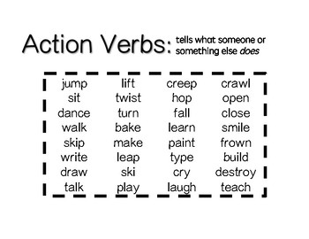

Slide 4
Non-action words, or non-action verbs, do not refer to an action as such, but represent a state of being, need, opinion, sense, or preference. Examples are the "be" verbs, like: am, are, was, were, is, has been, and had. Referring to the senses, some non-action words are: look, smell, feel, taste, and sound.

Slide 5
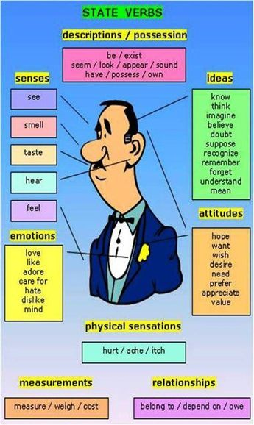

Slide 6
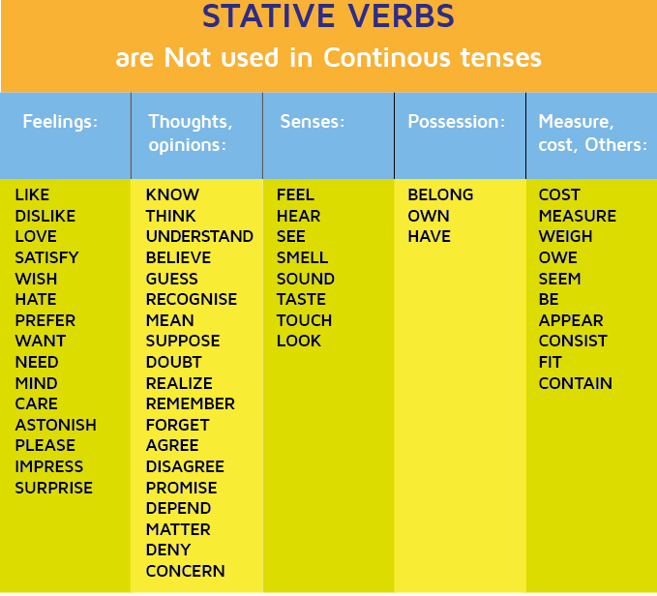

Slide 8
TASK:
Write 10 sentences:
5 sentences with action verbs and 5 with non-action verbs

